Slide 1
What is GitHub and why should I use it?

Slide 2


Richard Fennell
Chief Technology Officer (CTO)
MVP (Developer Technologies)
@RichardFennell

Slide 3

Notes:
Source control is your safety net
I am sure it was working, I want to go back version
Hardware failure
But there are other benefits
Aids experimentation

Slide 4



Source Control Choices
Centralised
Distributed
TFVC
Notes:
There are other, these are just the most common
Centralised or distributed
Discuss that centralised is like a library
Distributed is peer to peer
But in reality there is still one central copy that is the ‘source of truth’

Slide 5




What is Git?
Notes:
Developed in 2005 by Linus Torvalds, the famous creator of the Linux operating system kernel.
You can host your own copy
But there are providers who offer more
We will focus on GitHub as it is the most common

Slide 6
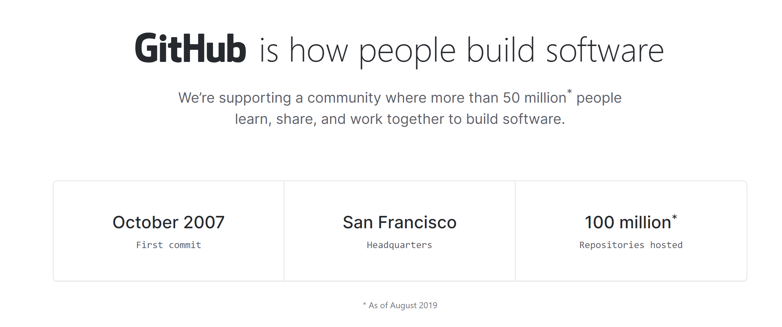
Purchased by Microsoft in June 2018
Notes:
Self hosted can be on your tin or in the cloud

Slide 7

GitHub is more than just source control
Git based Source Control, providing both public and private repos
Work Tracking using GitHub Issues
Automation using GitHub Actions for
Continuous Integration (build)
Continuous Delivery (deployment)
General automation
Package management using GitHub Packages
Reporting using GitHub Insights
Vulnerability Checking with DependaBot

Slide 8
Demo
Notes:
Show create create, work down the form
Discuss new/import/template/fork
Scope of a repo – a project
Public/Private
Standard files
Could import a sample with code from rfennell/demorepo, or have pre created, swap to it
Code
Mention branches and history
Issues
Add an issue to add a build
Note can assign, label, project to group
PR come back to them
Actions
Add a CI action – show it list sample
Pick manual and drop in sample code, and discuss, commit to a new branch
PR
Discuss PR
Show it run the build
Can set rules for a PR – this is the best tool to improve quality even if you one person
Discuss merge policies
Shows Projects, WIKI and Insights in another repo
Mention forks
Dependabot
This has all been in the browser, but normally edit on your machine
Clone
Codespaces (30sec to start)

Slide 9
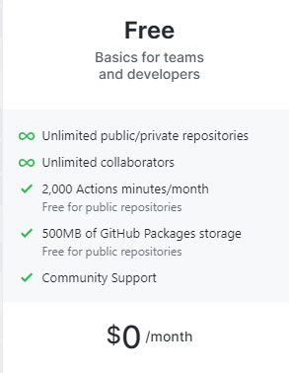
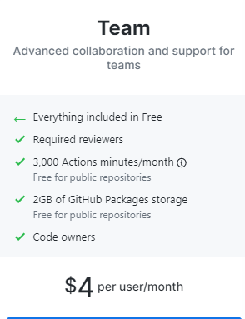
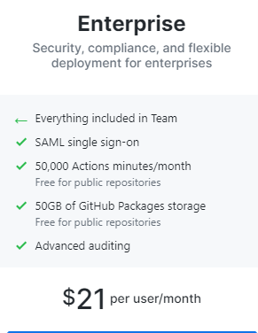
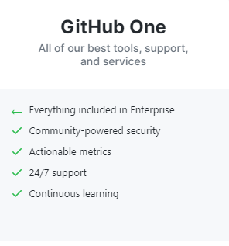

What does it cost?
Notes:
GitHub
Free
Team - $4
Enterprise - $21
GitHub One – ask
Can you VS MSDN + GitHub Enterprise

Slide 10

Summary
Use source control
Any source control
I really mean it use source control
GitHub provides a complete ALM solution
You can easily collaborate with others
GitHub is free for most student usage scenarios

Slide 11
Question?

Slide 12
Richard Fennell
Chief Technology Officer (CTO)
MVP (Developer Technologies)
@RichardFennell

Slide 13







sales@blackmarble.com
+44 (0)1274 300175
@blackmarble
Black Marble Ltd.
Black Marble

